Slide 1


Technical Design Thinking I
Spring 2025
Engineering & Software Design
Dr. Bruce McFall

Slide 2
Engineering / Software as a Profession
As a professional you will face situations where you have to make difficult decisions

Slide 3
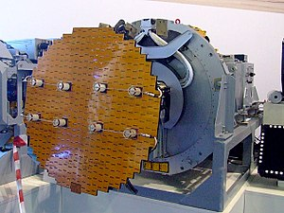
Professional Ethics Example
Following the ethical rules of engineering/programming in the workplace isn’t always easy, but the results can result in substantial gains in safety, performance, etc. and can bring great personal satisfaction
An example from my past work…
Radar Warning Receivers

Slide 4
Engineering & Software Design

Slide 5
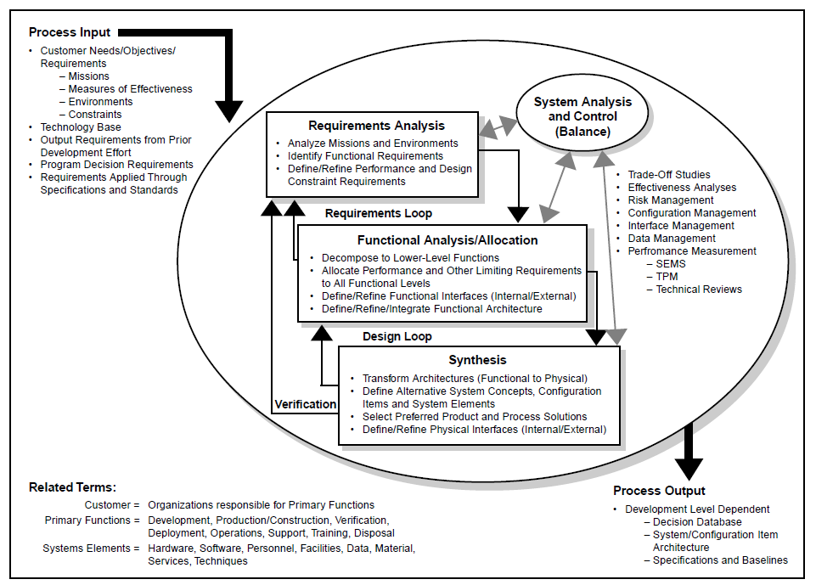
Engineering/Software Design Process - DoD

Slide 6
Criteria and Specification Development
Developing appropriate criteria and specifications is important because they are what you will use to determine whether your design is successful or not
Criteria - define the specific attributes for your final solution
Specifications are the specific targets you need to meet for each criteria
Criteria and specifications need to be:
Clearly defined
Measurable
Explicit in their targets
Directly related to stakeholder needs

Slide 7
Brainstorming
What is it?
A semi-structured, team-based method of rapid idea generation that’s been used for decades (skip the post-it notes)
What are the benefits (when done correctly)?
Quickly generate a large number of ideas
Diversity of participants fosters diversity of ideas
Allows for new ideas through combination and expansion of existing ideas
Helps get a team unstuck
Improves motivation and buy-in from the team

Slide 8
Brainstorming
So how do you brainstorm effectively?
Defer judgement: do not criticize any idea during the brainstorming process, evaluation occurs later
Encourage wild ideas: even though an idea may seem wacky, there may be some nugget of truth
Build on the ideas of others: while you may not come up with an idea, you might be able to think of an improvement on an existing idea
Stay focused on the topic: make sure you keep in mind the original problem so ideas are ultimately useful
One conversation at a time: if too many people are talking, you can lose important ideas
Be visual: a picture is worth a thousand words; writing things down or drawing pictures reduces cognitive load and can allow for more creative thinking
Go for quantity: the more ideas, the better

Slide 9
Testing
One of the most important, yet overlooked parts of the design process
Done well, it will almost guarantee successful implementation of the product being designed
Done poorly, it can lead to serious problems with final design implementation, safety, schedule and monetary issues
To do it well, testing needs to take into account all the criteria, specifications, and constraints identified during the design phase. Additionally, during the testing phase more constraints/criteria/specifications may need to be added
This is just a basic introduction to the rigors of the testing phase of design

Slide 10
Test Plans
A test plan is a document that outlines the types of tests to be performed, inputs, data to be collected and how these tests will show that you are fulfilling the criteria/specifications originally defined
Test plans are important because they:
Help ensure that you are testing the appropriate things
Provide a record of what tests were done and under what conditions they were performed
Help coordinate testing with other members of design team

